Slide 1


Slide 2
Introduction
Welcome to this Live Session which is arranged for Freshers and Students.
This Live Session is arranged for choosing your way according your Degree Computer Science and Information Technology.
Do not waste your time. If you want to waste your time, then must think about your Future.
Let's think about this how Money comes into a student's pocket.
Our Parents do hard work , day and night for our Successful Future and Life. Then they spend money on our wishes like you want to do BS in IT, CS or other Degrees but Mostly in PAKISTAN at the end of Degree ,we have not any thing without a paper of Degree.

Slide 3
Session Objective
Identify the of your degree & also Identify your Skills.
Identify Market Expectations From you.
What is Java ?
History of Java
Why use Java?
Where is Java used?

Slide 4
Identify your Degree & Skills
In Programming Field, it does not matter which degree you have b/w CS & IT.
But When you have chosen a good way according to your Degree then you have a good Profile in Society.
You have learned from your Lectures in which provide some basic knowledge of Programming Languages and other techniques.
These degrees help new software developers in two key areas by improving their problem-solving skills and ability to learn new techniques and technologies.
The skills and techniques students pick up while studying topics like data structures, algorithms and computing fundamentals directly translate to making developers better at this process.
If you have these skills which is defined above, then you picked y A Good Company
You Put your Skills and They Give You a lot of things.

Slide 5
Market Expectations
1. Artificial Intelligence & Machine Learning
J.A.R.V.I.S from Iron Man
Back-End Development
Python
Java
JavaScript
Node.js
PHP
Front-End Development
HTML5
CSS3
JavaScript
Angular.js
React.js
UX/UI Design
Full Stack Engineers
IT Managers
Networking
Quality Assurance Experts

Slide 6

What is Java ?
Java is a general-purpose, class-based, object-oriented programming language designed for having lesser implementation dependencies. It is a computing platform for application development.
Java Platform is a collection of programs that help programmers to develop and run Java programming applications efficiently. It includes an execution engine, a compiler, and a set of libraries in it. It is a set of computer software and specifications.

Slide 7
History of Java
Language Designed By James Gosling in 1991
Developed By Sun Microsystems (ORACLE CO OPERATION)
First Version May 23rd, 1995 (JAVA 1.0)
Latest Version March 16th, 2021, (JAVA 16.0.2)
File Ext .java , .class , .jar
Java was known As “OAK”

Slide 8
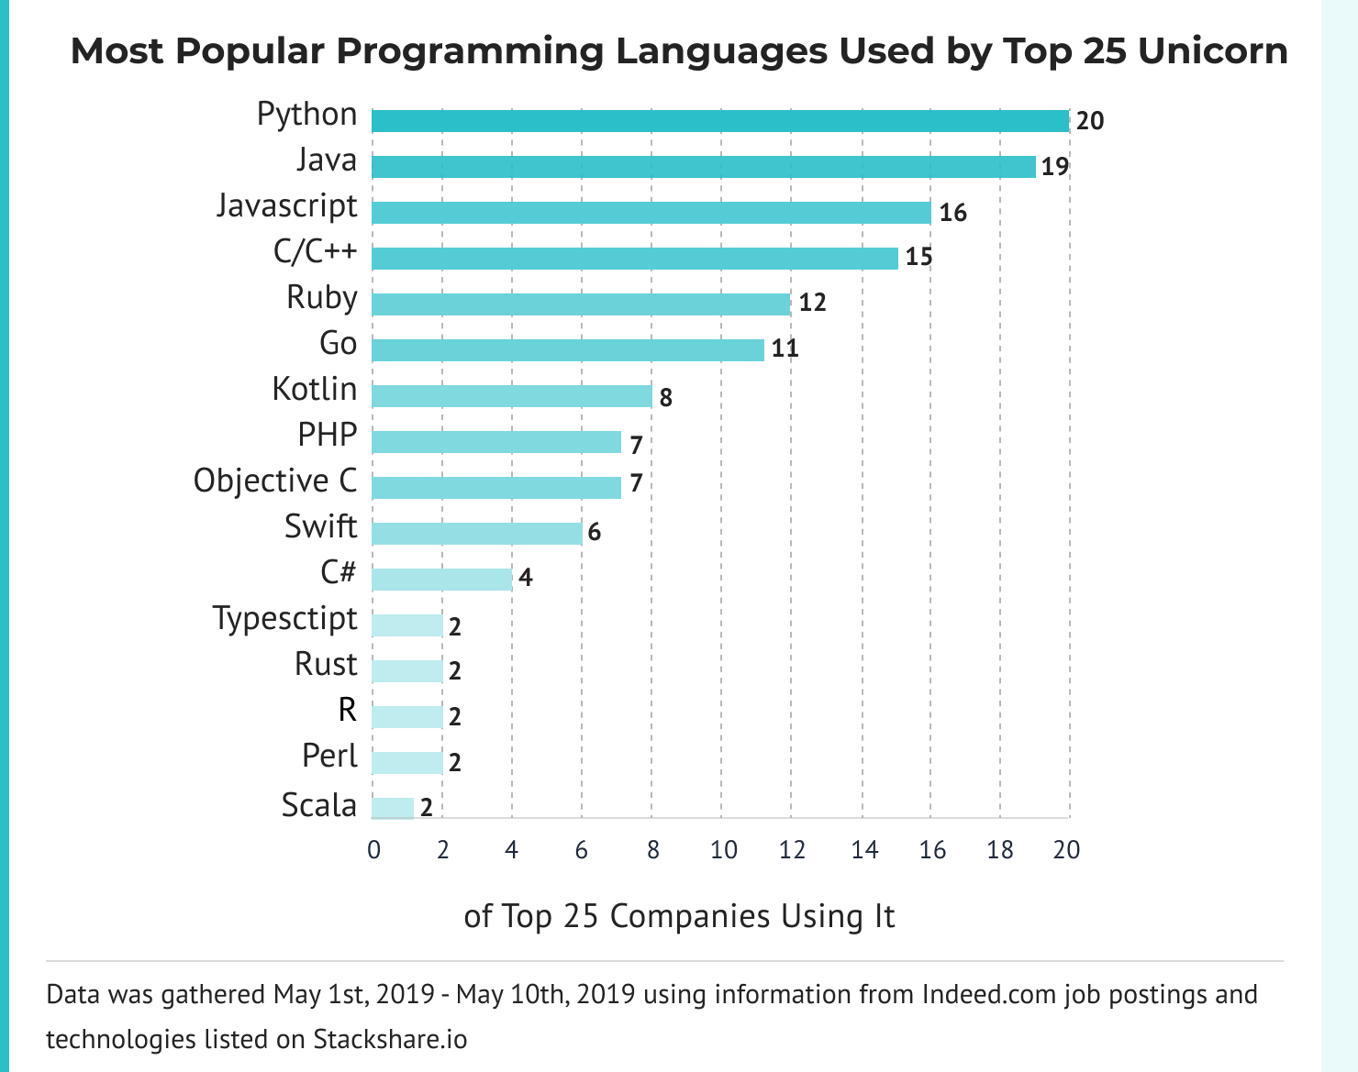

Slide 9
Advantages of Java
Java is Simple
The syntax of Java is straightforward, easy to write, learn, maintain, and understand, the code is easily debug gable.
Java is an Object-Oriented Programming language
Java is an object-oriented language that helps us to enhance the flexibility and reusability of the code. Using the OOPs concept, we can easily reuse the object in other programs.
Java is cheap and economical to maintain
Java programs are cheap to develop and maintain as these programs are dependent on a specific hardware infrastructure to run. We can easily execute them on any machine that reduces the extra cost to maintain.
Java is a high-level programm4ing language
Java is a high-level programming language as it is a human-readable language. It is like human language and has a very simple and easy to maintain syntax that is like the syntax of C++ language but in a simpler manner.

Slide 10
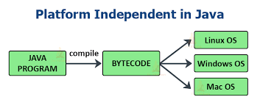
Advantages of Java(CONT)
Java is platform-independent
Java provides Automatic Garbage Collection
Whenever the objects are not used by programs anymore and they do not refer to anything that they do not need to be dereferenced or removed by the explicit programming.

Slide 11
Disadvantages of Java
Java provides not so attractive look and feels of the GUI
There are many popular frameworks such as Swing, SWT, JavaFX, JSF for creating GUI. But they are not mature enough to develop a complex UI. Choosing one of them which can be suitable for you may require additional research.
Java provides no backup facility
Java mainly works on storage and not focuses on the backup of data. This is a major drawback that makes it lose the interest and ratings among users.
Java requires significant memory space
Java requires a significant or major amount of memory space as compared to other languages like C and C++. During the execution of garbage collection, the memory efficiency and the performance of the system may be adversely affected.
Java is slow and has a poor performance
Java is memory-consuming and significantly slower than native languages such as C or C++. It is also slow compared to other languages like C and C++ because each code has to be interpreted to the machine level code.

Slide 12
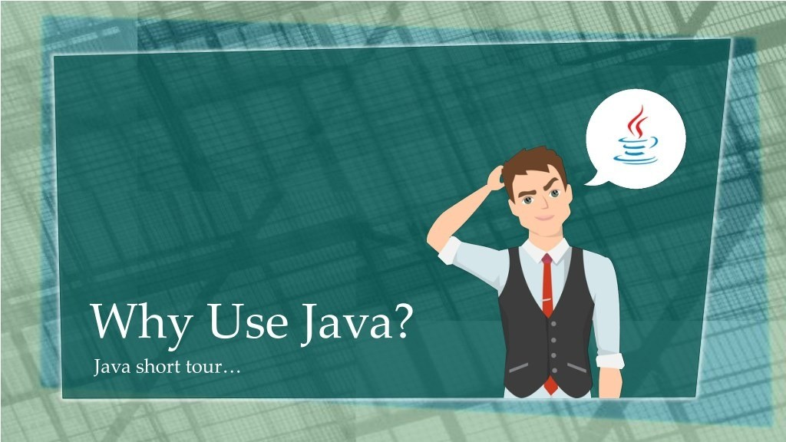
Java is easy to learn.
Java was designed to be easy to use and is therefore easy to write, compile, debug, and learn than other programming languages.
Java is object-oriented . This allows you to create modular programs and reusable code.
Java is platform-independent . One of the most significant advantages of Java is its ability to move easily from one computer system to another. The ability to run the same program on many different systems is crucial to World Wide Web software, and Java succeeds at this by being platform-independent at both the source and binary levels.

Slide 13
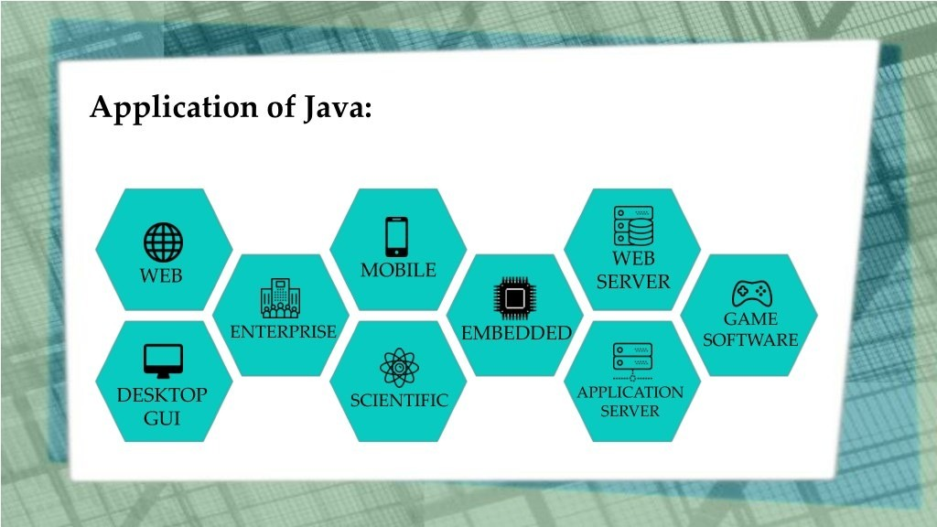
Where is java used ?

Slide 14
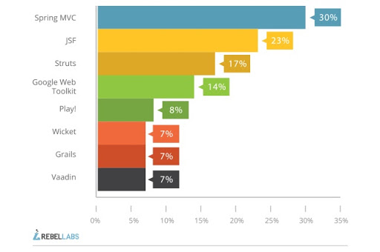
Most popular java Frameworks 2021

Slide 15
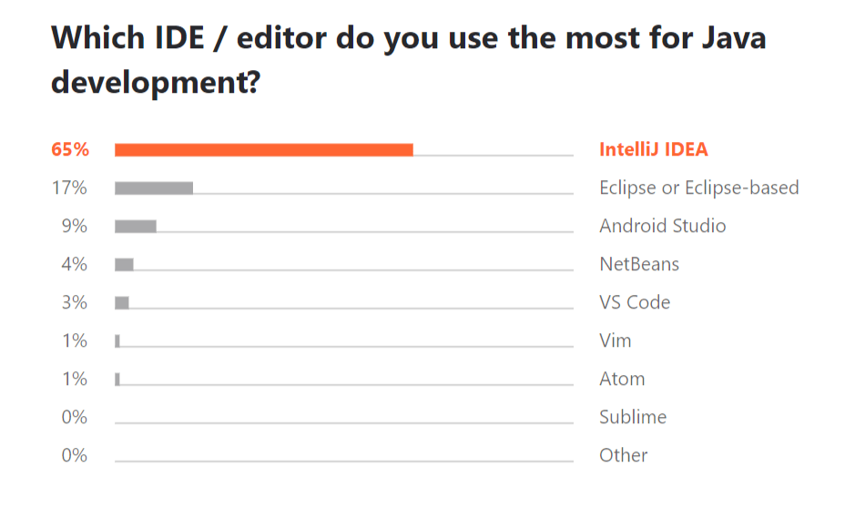
most popular Ids for Java

Slide 16
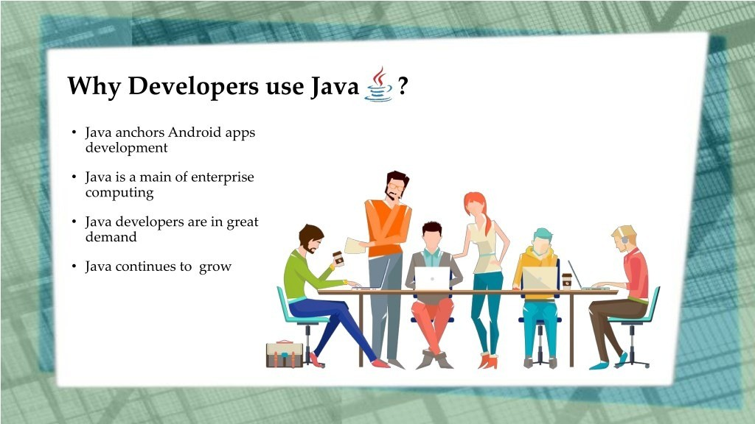

Slide 17
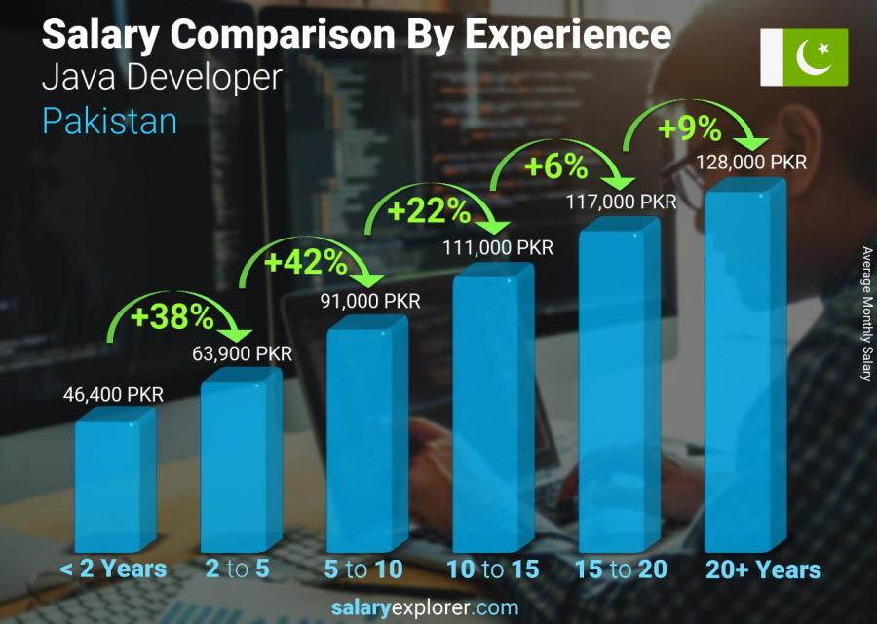

Slide 18


